Slide 1
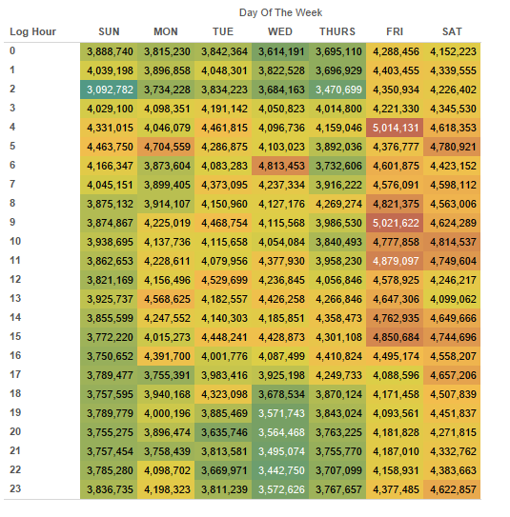
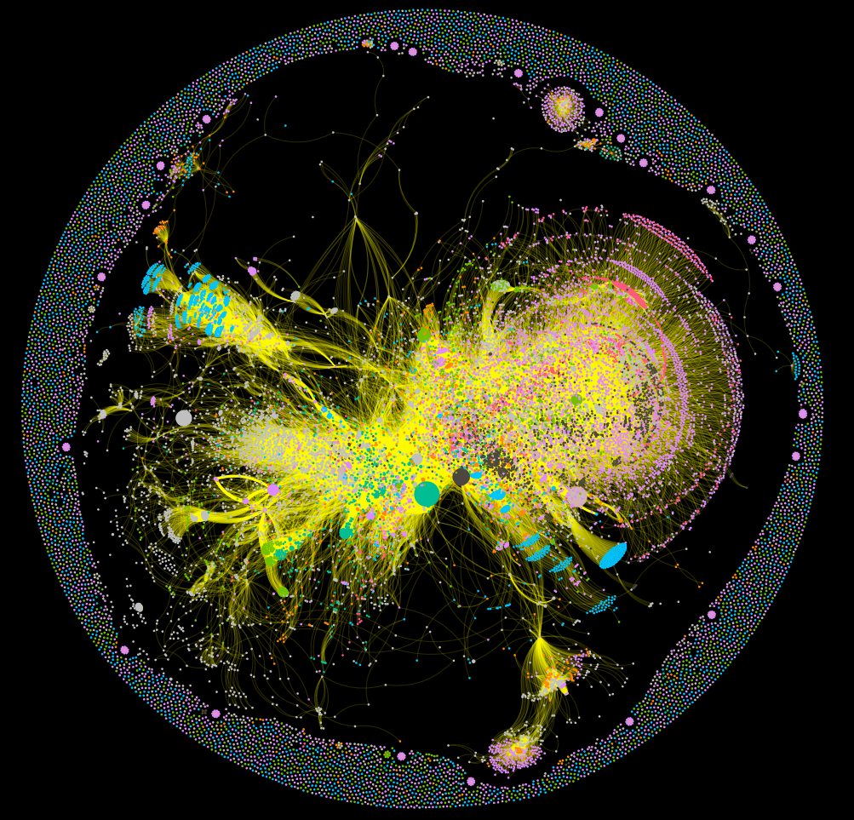
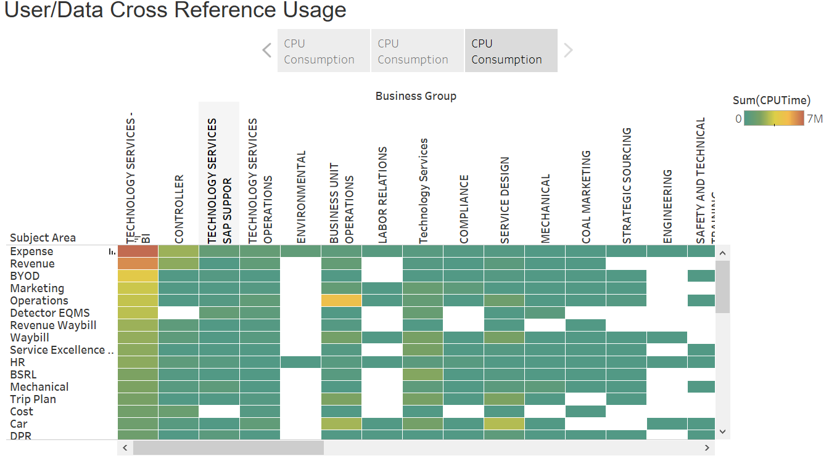
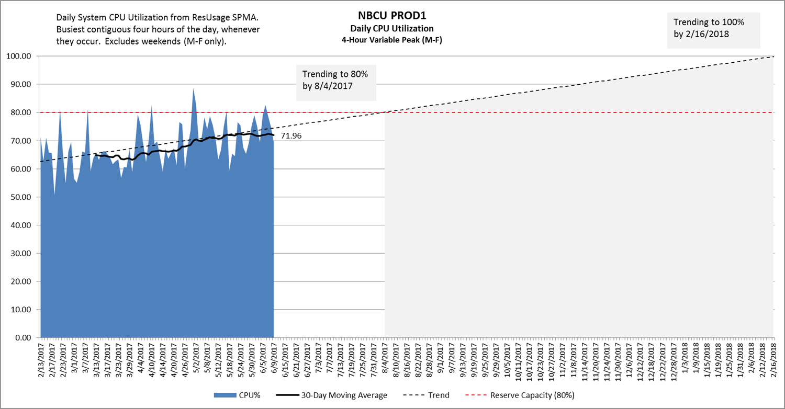
Vantage Health Check
Vantage Health Check
What is it? | Vantage Health Check is a routine service Teradata provides for customers to help them understand their usage of the Vantage platform.
What do I get? | A report detailing the usage of the Vantage Platform along the dimensions of: Resource usage (Compute & Storage) Workload Profile Data Affinity Feature Usage (if on Teradata 16+) User Profile (optional) Data Usage Profile (optional)
What do I need? | The health check requires the following data: ResUsage and Database Query Log (DBQL) DBQL Object logging (for Data Affinity) Feature logging (for Feature Usage) User group mapping (optional, requires customer input) Data subject area mapping (optional, requires customer input) SQL will be supplied to the DBA for execution and extraction of the results for visualization
How long does it take? | Teradata will take 1 week to complete the analysis and produce the report. There is no charge for the Initial Baseline service.
Potentially Sensitive Data
What is extracted? | Username Database name Table name CPU, IO and Diskspace metrics
©2020 Teradata

Slide 2
Teradata Vantage Health Check
{{val:intro.csv[1,Customer_Name]}}
{{val:intro.csv[1,Your_Name]}}
Ecosystem Architecture Practice
{{val:intro.csv[1,FullDate]}}

Slide 3
Executive Summary

Slide 4




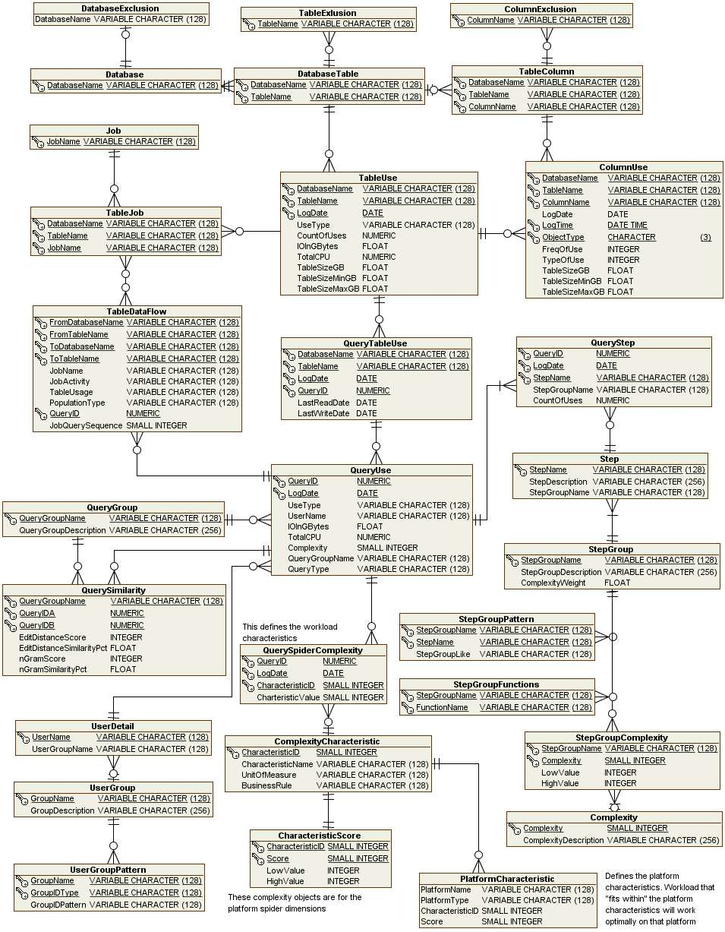
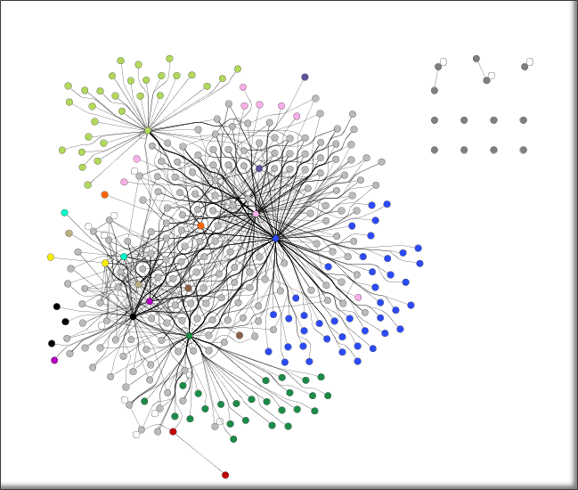
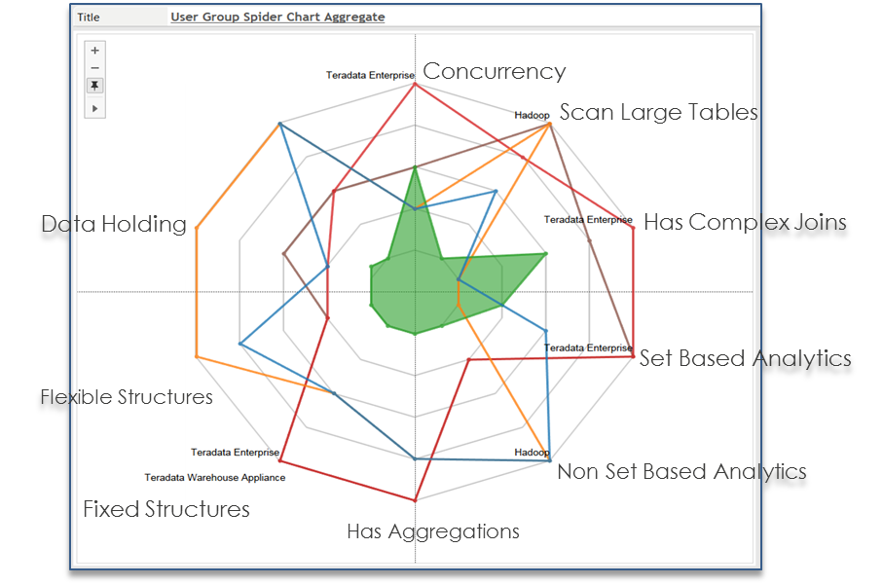
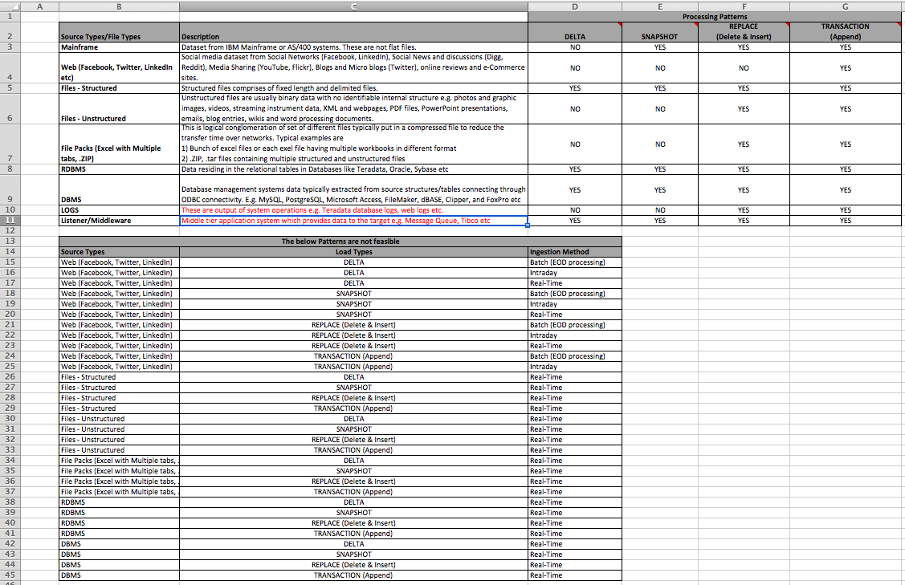
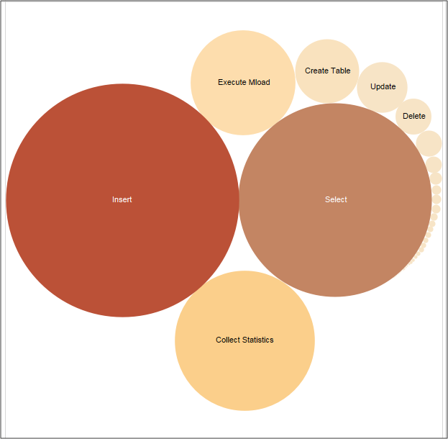
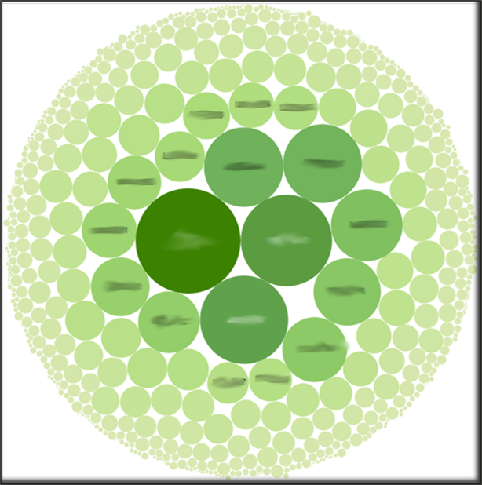
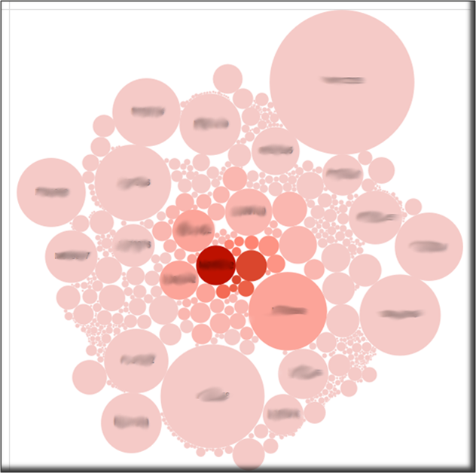
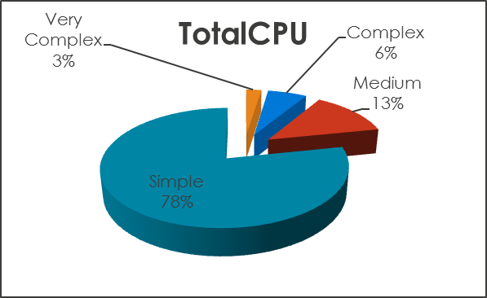
Vantage Health Check Our Vantage Ecosystem Optimization Process
Largely Automated
Guided Analysis
Capture data and processing metrics from platforms.
Extract and Transform data and processing metrics. Transformation process moves metrics from platform-specific representation to cross-platform representation.
Place Data and Processing Metrics in Generalized Metadata Model to support multiple cross-platform analysis.
Perform Analysis of Platform Metadata across the Data and Processing Dimensions.
Analytics: Classify, Affinity, Sameness, Filter, Access Path, Frequency, Volume, Cost, Complexity, Users, Lineage, Impact.
Align Candidate Data and Processing dimensions to Appropriate Platform, RDBMS, Hadoop/Spark/Open Source, other.
Decide Which candidate Data and Processing migrate based on facts and analysis.
Other Platforms

Slide 5
Key Observations and Recommendations
Observations
{{ MANUAL NOTE: add comments as it pertains to your customer. Below are some examples only – change for your customer }}
The overall processing framework appears to adhere well to the concept of 3-Tier Data Architecture and evidence of good design is exhibited thru complex ETL design broken down into small steps and simple queries.
In terms of data export there is a significant amount of data movement (70,000+ queries per day) copying tables directly to the SAS platform with large volumes then being loaded back to Vantage. Both direction of this data exchange could be optimised considerably to reduce unnecessary data latency and data movement / duplication.
Datalabs are reasonably extensively utilised and some of them are relatively large and well used, It is likely that some of these should be optimised, promoted to production and more widely leveraged across Customerx.
From the analysis it appears that there is only limited use of all the Operational Image data that is being loaded into the environment. Only select data elements are being promoted thru data model. Customerx is following the best practice of “touch it, take it” for source file data but it is likely there is considerable more value that can be gained from the source data being loaded in Tier 1.
Overall the system is performing well with plenty of resource available to take on additional workloads. The IO utilisation is trending upwards and if tat continues additional resources will be required around August 2021 and/or optimisation activities around IO consumption undertaken.
Many features of the Vantage software are not being utilised by Customerx and utilisation of many of these could improve overall performance and experience of the end users and avail Customerx to analytics and insight from their data assets that they aren’t realising today. These features include bit are not limited to Columnar, Geospatial, Time Series and Path(n) analysis

Slide 6
Key Observations and Recommendations
Recommendations
Too many unused working tables could potential impact on system performance, we do recommend a automate process to do a peroral clean up.
BI and Analytic workloads are using significant higher proportion of the system resource, suggest more governance and tunning to be introduced.
Consistently see trickle feeds happening in the system, suggest workload rules to be reviewed.
It appears that SAS users are using traditional approach with data preparation, e.g. pulling data out of Vantage and carry on joins, filtering works in SAS server, there is a join effort put together by SAS and Teradata called SAS in Teradata which can do data preparation in Vantage, potentially increase analytic productivity significantly.
Recommend a governance and guidance to be added to Sandpits teams.
Teradata Vantage have been added 100+ new features and functions, which aimed to simplifier the query coding, increase productivity and efficiency, it is highly recommend to explore those new features and functions.

Slide 7
Outline
Purpose and Context
Purpose
System Summary
Key Findings
Recommendations
Analysis and Findings
System Consumption
Feature Usage
Workload Profile
Data Affinity
Data Usage Profile
User Profile
Appendix – Feature Usage Grouping
Notes:
System Consumption – CPU / IO / Disk
Feature Usage
Workload Profile
Query Concurrency
Query Complexity (table joins)
Mixed Workload
Data Affinity
Data Usage (profile)
User Profile

Slide 8
Outline
Purpose and Context
Purpose
System Summary
Key Findings
Recommendations
Analysis and Findings
System Consumption
Feature Usage
Workload Profile
Data Affinity
Data Usage Profile
User Profile
Appendix – Feature Usage Grouping
Notes:
System Consumption – CPU / IO / Disk
Feature Usage
Workload Profile
Query Concurrency
Query Complexity (table joins)
Mixed Workload
Data Affinity
Data Usage (profile)
User Profile

Slide 9
Purpose
Vantage Health Check is a routine service Teradata provides for customers to help them understand their usage of the Vantage platform.
This report provides information to help {{val:intro.csv[1,Customer_Name]}} to understand its analytic environment through understanding:
Resource usage (Compute & Storage)
Feature usage
Workload profile
Data Affinity & Usage
User Profile
Teradata consultants analyze the query workloads on the Vantage environment based on a window of {{val:weeks.csv[1,Weeks]}} weeks.
This involves analysis of database query logs (DBQL) from the Vantage platform and the only dependency is DBQL (database query logging) being enabled for the analysis window.

Slide 10
System Summary
<config> nodes with 512Gb memory + <config> standby nodes
Database Version {{val:intro.csv[1,Database_Version]}}
Total Current Used Space as of 14-Nov-2018
<num> Databases (Databases with tables)
<databasename> (10,403 tables)
Sample Period from Apr 2019 to May 2020
Total Queries in the Period are 151,937,750
This is in the higher range from other engagements
All Maintenance (ETL or data preparation): 71,247,130
All Select: 80,690,620
Daily Average All Queries: 3,453,130
Daily Max All Queries: 5,325,366 (12th May 20)
CurrentPermTB | maxPermTB | FreePermTB
xxxx | xxxx | xxxx
Top three users of the Teradata production platform
<user> 24,717,543 (Queries)
<user> 17,657,196 (Queries)
<user> 7,105,911 (Queries)

Slide 11
Key Findings
KEY OBSERVATIONS & RECOMMENDATIONS
Production Performance
The processing profiles of workloads loads running on the Production Platform are performing within the capability boundaries of the Teradata system but are at the top end of the current CPU capacity.
However, the platform is CPU constrained with load jobs for <app> (app) and Master Data Management (MDM) being large consumers.
Data maintenance (ETL) queries consume approx. 80% of the CPU and I/O.
Potential to Optimize (Prioritised)
34 TB of non active space exists on the system which is a candidate for clean up/backup and may help reduce weekly backup timings and will help in the upgrade process.
There is high I/O when the <tablename> table is accessed. There is an opportunity for Physical tuning (Partitioning etc…)
Work databases have large number of objects that are used once or twice, <tablename> has thousands of objects. There are Utility databases that are not cleaned up after load jobs (UT and EV tables).
Review jobs for <app>, but a wider review of batch architecture will be beneficial.
Other than the points above, high number of tables or clusters of tables are isolated and candidates for clean-up or backup (subject to analysis of their query profile), most medium or large tables are heavily used in conjunction with other tables.

Slide 12
Recommendations
Clean up inactive data
Utility and other Temporary space areas has a potential to return up to 34 TB of user space.
May lead to reduced backup time (verify is excluded from backup)
Advised to be complete prior to any upgrade/migration.
Inactive data, if required to be retained, can be migrated offline
Physical Tuning of Large CPU and I/O Consuming Tables
Focus tuning on reducing CPU usage
Multi-Value Compression
Indexing and Partitioning
Aggregate Join Indexes
Review unused indexes
Review statistics

Slide 13
Recommendations continued…
Focus on Migrating to new Platform
New platform has capacity for current and new workloads.
Investigate use of new Teradata Software Features
To optimize legacy code
Reduce resource consumption
Establish a regular monitoring Process
It is recommended to have this engagement run on a regular basis to provide an up to date state on the system. This will help maintain a healthy system state throughout the year. This will also help in providing quick indicators for performance management activities.

Slide 14
Outline
Purpose and Context
Purpose
System Summary
Key Findings
Recommendations
Analysis and Findings
System Consumption
Feature Usage
Workload Profile
Data Affinity
Data Usage Profile
User Profile
Appendix – Feature Usage Grouping
Notes:
System Consumption – CPU / IO / Disk
Feature Usage
Workload Profile
Query Concurrency
Query Complexity (table joins)
Mixed Workload
Data Affinity
Data Usage (profile)
User Profile

Slide 15
System Consumption Findings
What is the long term change in consumption/storage?
Plenty of headroom in the system currently – CPU, IO and Storage
Has the pattern changed recently?
Since migration to cloud resource utilisation has reduced due to 14.0 to 16.20 Upgrades
When will the system become congested/full?
IO trend growth will result in system congestion by August 2021, possibly impacting user experience and application SLA’s.
Are there outliers or anomalies that should be investigated further?
The significant low CPU usage (35%) need to be instigated further, over provisioned system?
From the heatmap, is there periods of time where workload can be added/shifted?
The compute heatmap shows system is quiet in the afternoons and evenings.
Opportunity to enable more users to access the system directly and bring more analytics in-database
Which databases are outliers for consumption? Why?
The 3-Tier Architecture databases are the most resource-intensive and space-intensive
however a xxx_T is the next most resource-intensive
some sandpit databases are storing high volumes of tables and data but are not being accessed much at all
Investigate the need/usage of all the sandpits

Slide 16
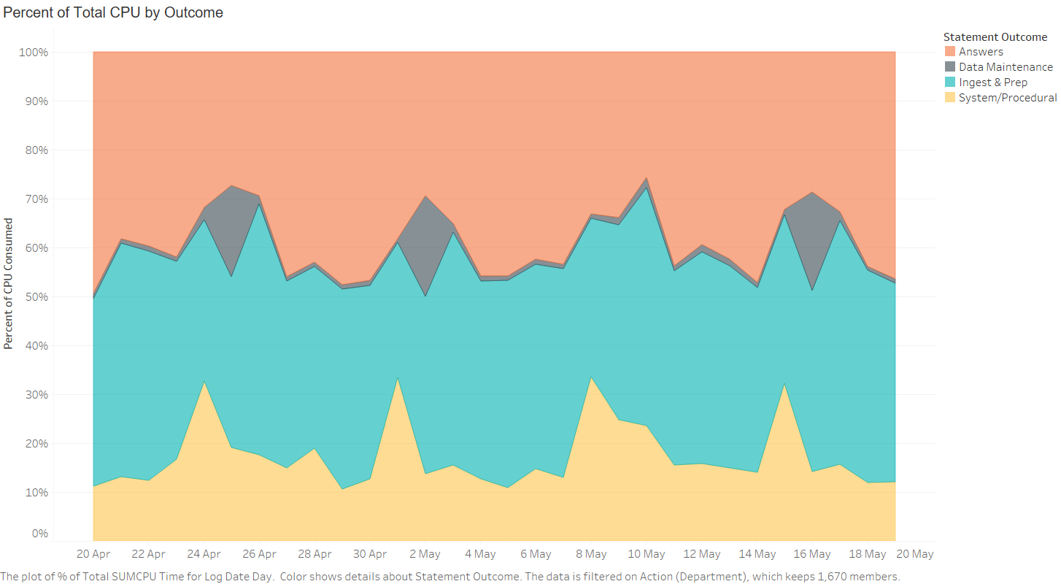
Consumption (CPU) by Outcome
Vantage Health Check has four classifications
We can change the classification based on this slide as well which provides more bucketed analysis
Notes:
Done ( Currently based on SQL joined to ref table)
Tablean sheet: PercentTotalCPU

Slide 17
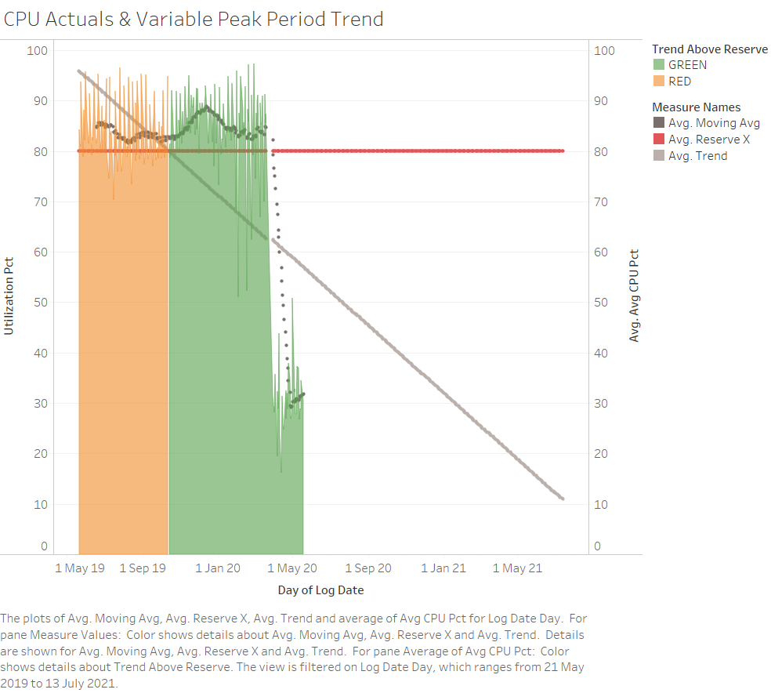
Usage Trending & Forecast – CPU
Peak system utilization drastically reduced end March due to optimizer improvements between TD 14.0 and Vantage SQLE 16.20 and CPU rich system on AWS
Peak utilization is now averaging around 35% of system and on a slow growth path. This provides ample scope to open system up to more users, expand workloads, introduce new workloads and optimize analytics to use more of the Vantage engine.
Notes:
Done
Tableau Sheet: CPU Actuals & Variable Peak Period Trend

Slide 18
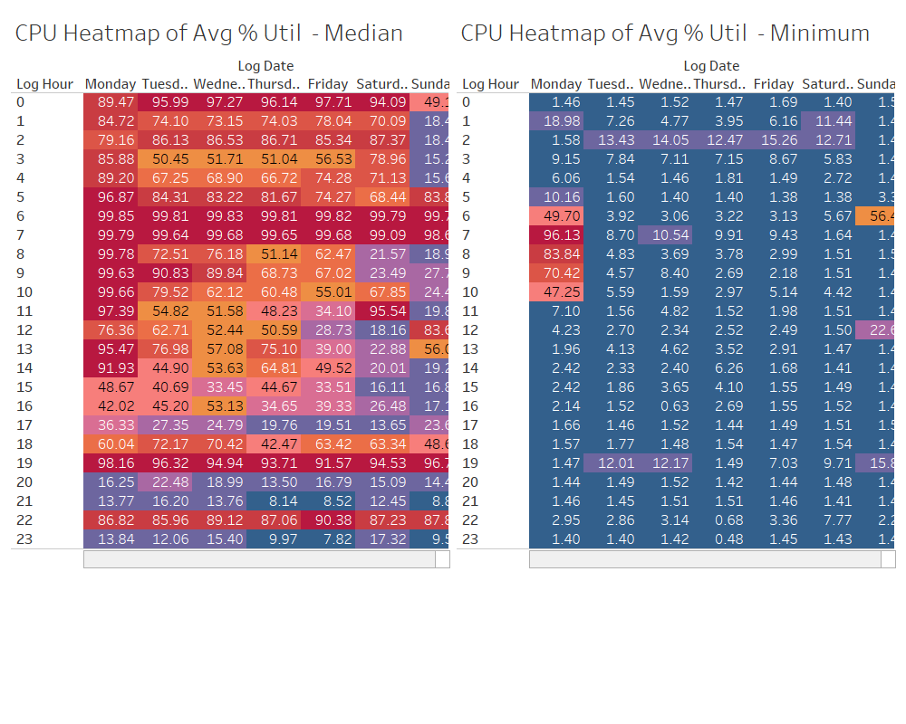
System CPU Heat Map
Finding(s):
Busiest CPU times are early mornings and Fridays late to mid morning
Afternoons and evenings exhibit low utilisation – may point to the use of offline reports.
Implication(s):
Investigate possibility of bringing reports online and enabling more self-service and in-database analytics for business users?
Notes:
Already included as part of Consumption Analytics
Tableau sheet: CPU Heatmap of Avg % Util - SPMA Detail

Slide 19
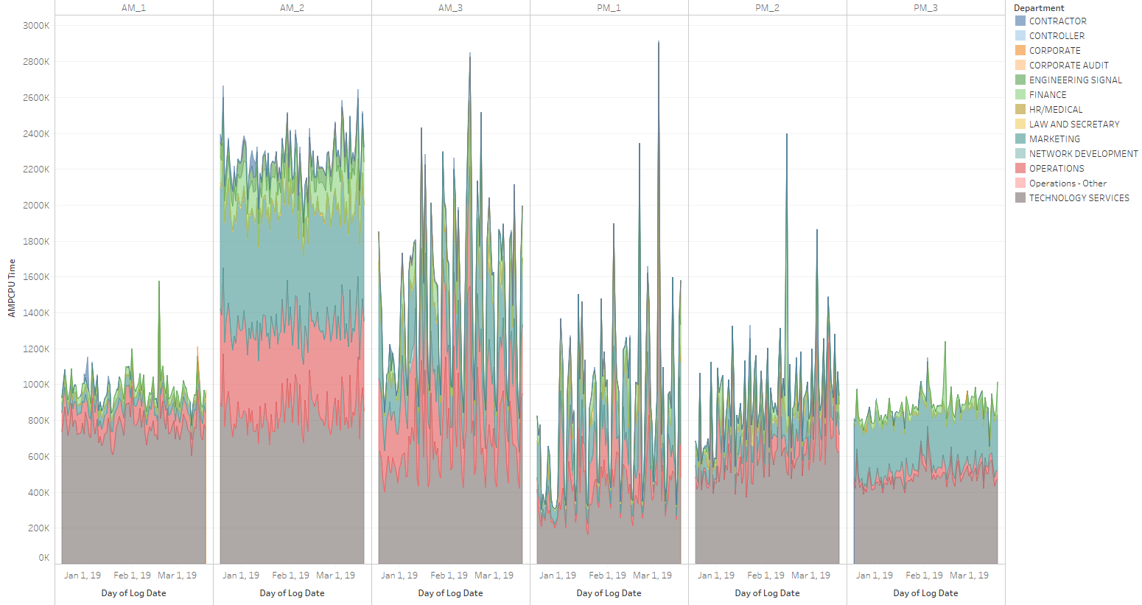
Consumption (CPU) By Operating Window
Interesting to see consumption in different User defined Time Windows across Business Groups or Data Domains.
Notes:
Done( With User Level)
Tableau sheet: CPU Consumption By Operating Window

Slide 20
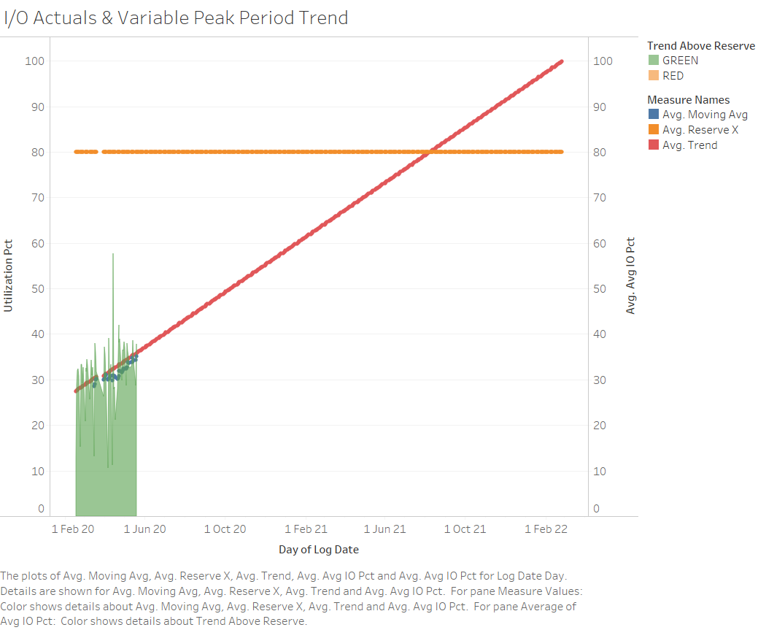
Usage Trending & Forecast – IO
Peak I/O utilization % is slowly growing from a low base of around 35%
However, the trend of that growth means IO could be saturated by August 2021 without expansion of the system before that time.
Average Daily Utilization in 4-Hour Peak
Notes:
Tableau sheet: I/O Actuals & Variable Peak Period Trend

Slide 21
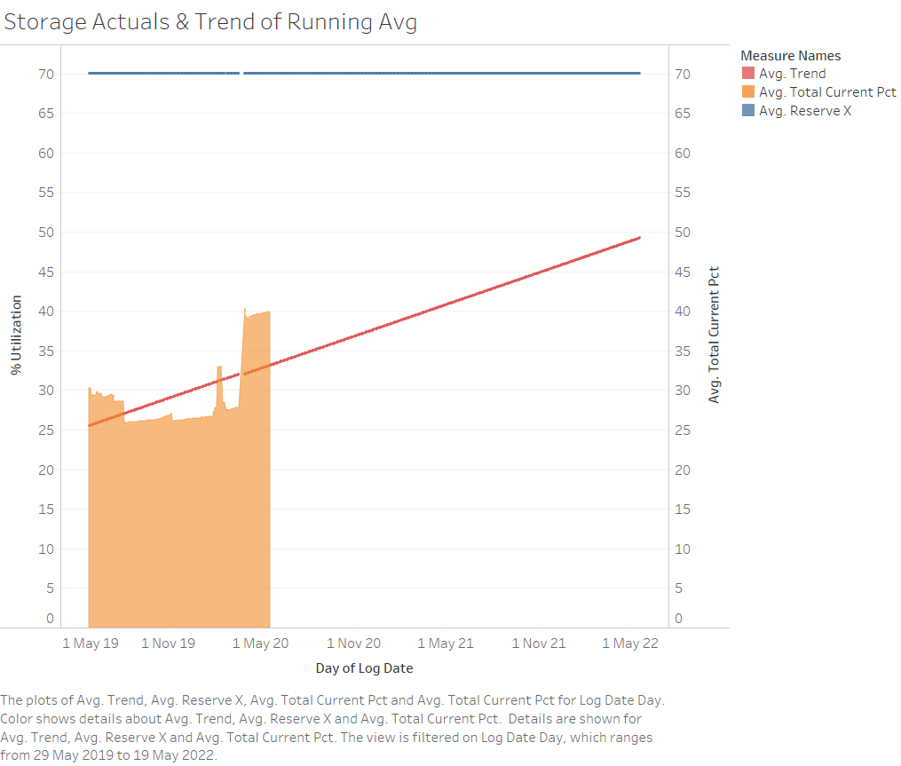
Space Consumption by Historical Trend
{{ valr: PNG}}
Total Storage (in TBs) dropped in AWS due to global block-level-compression on the AWS system
Notes:
Tableau sheet: Storage Actuals & Trend of Running Avg

Slide 22
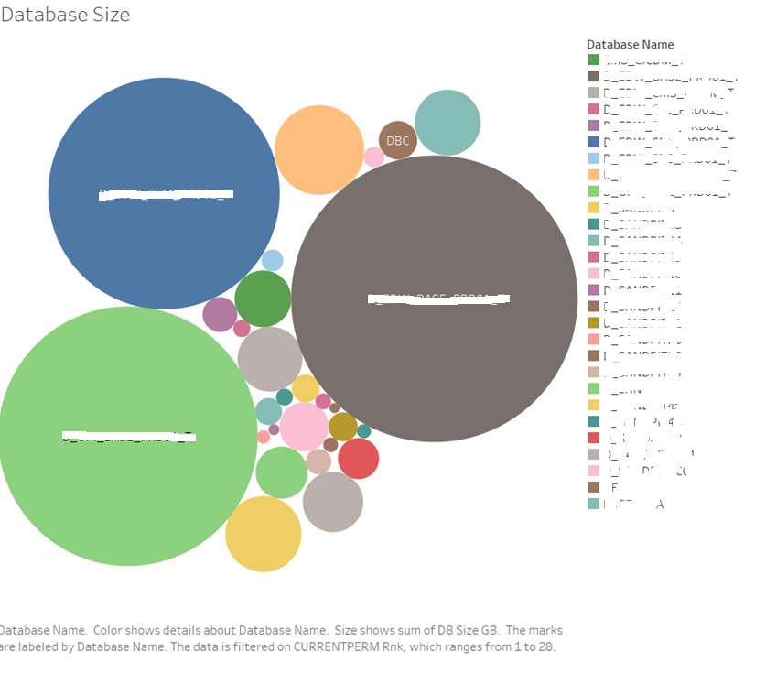
Production Database Sizes
By data volume, the 3 tiers of the data architecture (operational image, integrated layer and semantic layer) are the 3 largest databases
This reflects good practice in physical data management
Multiple Sandpits are prominent in terms of data stored
Some of these sandpits could be obsolete – therefore storage could be saved by dropping some of these.
Notes:
Done
Tableau sheet: Database Size

Slide 23
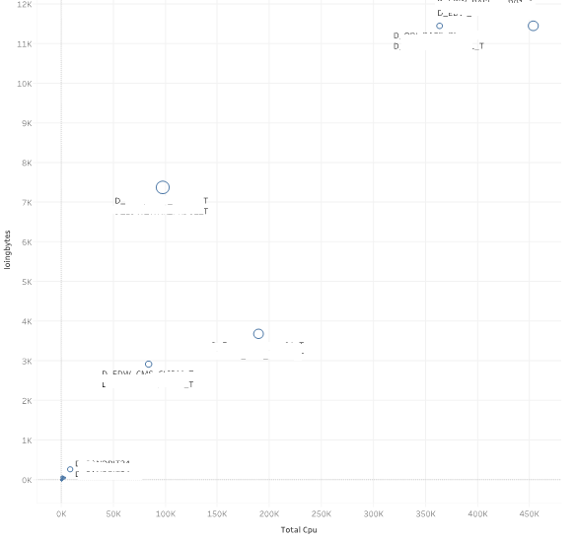
Database Activity Summary
Good to see the 3 data architecture tiers are attracting the most CPU and IO.
Again, sandpit databases are the next most prominent resource hungry databases – but not a fuge usage to worry about.
Notes:
Tableau sheet： Activity By Database

Slide 24
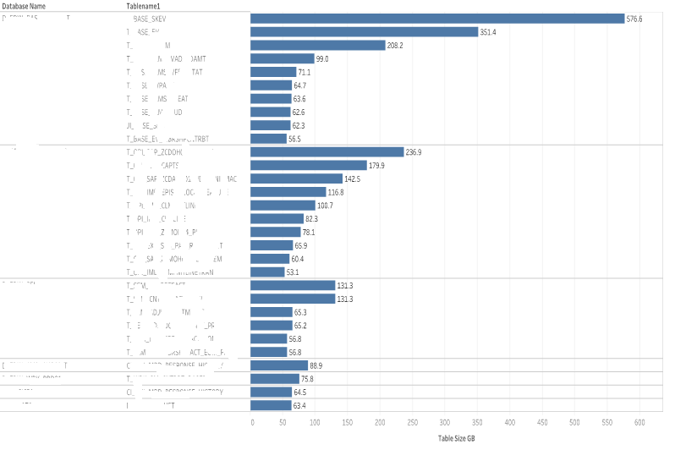
Top 30 Tables by volume (GBs)
Good to see some of the largest tables are in xxx
Some Semantic Fact tables are quite large
Could any of these be delivered via a view
Seems to be duplicate versions of xxx
Are those large table designed properly
Notes:
Tableau sheet: Top Table Size

Slide 25
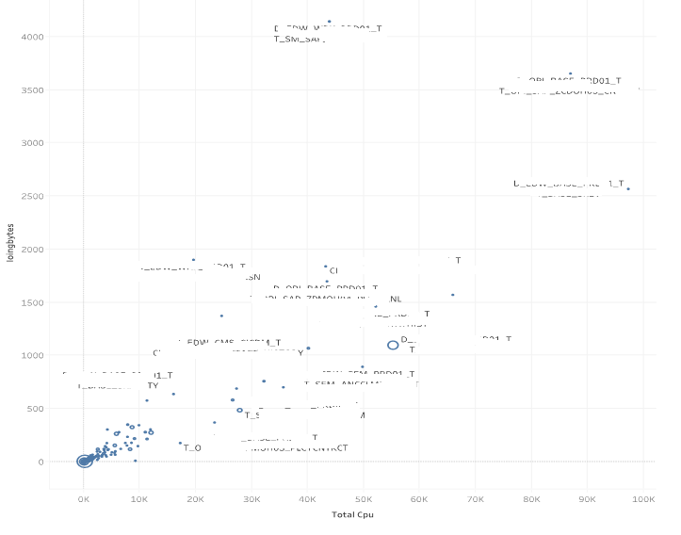
Table Activity Summary
Some CMS tables are attracting high levels of CPU and IO
Why is the SAP operational image table attracting the highest CPU and IO
Likely a table structure that needs tuning or indexes added
Notes:
Pending

Slide 26
Outline
Purpose and Context
Purpose
System Summary
Key Findings
Recommendations
Analysis and Findings
System Consumption
Feature Usage
Workload Profile
Data Affinity
Data Usage Profile
User Profile
Appendix – Feature Usage Grouping
Notes:
System Consumption – CPU / IO / Disk
Feature Usage
Workload Profile
Query Concurrency
Query Complexity (table joins)
Mixed Workload
Data Affinity
Data Usage (profile)
User Profile

Slide 27
Feature Usage Findings
What features are being used in the system?
Primary Index and Multiset/Set Table, Table Functions, Query logging, Small Large Object, non-Unique hashed index and Parameterised Queries are being used extensively
What additional features could be used to deliver value?
Columnar could be used more to drive performance of interactive reporting and OLAP queries, thereby improving productivity of data analysts. Also, Querygrid could be used to enable access to/from Hive and Spark platforms for analysts who need to access cross-platform data quickly.
Collect and Stats usage logging could be used more to optimise statistics collection and ensure the stats are more targeted.
With In-database Analytics features a lot more could be leveraged such as 4D analytics (geospatial, temporal and time series), R and Script Table Operator and JSON data type
Do any features stand out when looking at consumption?
Columnar is a feature that could be utilised in the FACT tables of the semantic layer – this will cut down the IO of reporting queries on those tables and improve performance and end-user productivity
4D Analytics will help Customerx with Fraud use cases (temporal), IOT data feeds and analysis and Geospatial analysis (e.g. member locations vs. provider locations)
For high consumption features can we tune or suggest alternatives?
Investigate whether Multiload provides more flexibility and supportability compared to Fastload.
Are there teams using groups of features that could share and collaborate with other teams to enable new value?
Team xxx use autocompression which others team are not, recommend that team XXX host a lunch and learn session with other teams to share the benefits and best practice from using the feature.

Slide 28
Feature Usage – Data Optimisation
Columnar could be used to optimize Semantic Layer
Explore the use of Multiload to provide more flexibility in loading logic and data management
Explore the need for Querygrid to enable Vantage queries to access data in other platforms, and vice-versa.
Notes:
Tableau sheet: UX-Feature Usage

Slide 29
Feature Usage – High Availability and Usage Analysis
Collect Stats and DBQL STATSUSAGE Logging could be used more to target statistics where the workload requires them.
Notes:
Tableau sheet: UX-Feature Usage

Slide 30
Vantage Feature Usage - Performance
Join indexes could be used more to reduce the need to copy the data to Semantic Layer by delivering performant views. This also significantly reduces the time (latency) for data to be available in the Semantic layer for end-users.
Notes:
Tableau sheet: UX-Feature Usage

Slide 31
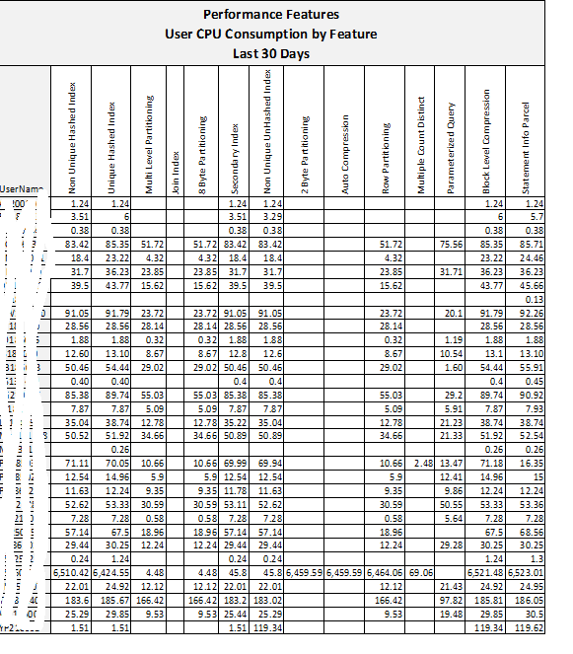
Feature Usage Logging
By User
Feature Usage by User
Maps Feature Names to users executing queries using those features
Determine the features driving usage on the system and who is using them
Identify users with highest consumption and provide tuning services to ensure the best user experience
Notes:
Tableau sheet: Feature Usage By User

Slide 32
Outline
Purpose and Context
Purpose
System Summary
Key Findings
Recommendations
Analysis and Findings
System Consumption
Feature Usage
Workload Profile
Data Affinity
Data Usage Profile
User Profile
Appendix – Feature Usage Grouping
Notes:
System Consumption – CPU / IO / Disk
Feature Usage
Workload Profile
Query Concurrency
Query Complexity (table joins)
Mixed Workload
Data Affinity
Data Usage (profile)
User Profile

Slide 33
Workload Profile Findings
What kind of workload is present on the system?
Balanced between Batch and Extract / User workload, mixed workload
Does the query volume and compute usage align with the type of work?
High volume and proportion of simple queries points to good ETL architecture and design, however, likely there is missed opportunity in terms of complex analysis being performed on Vantage.
High CPU proportion of “Select” workload with lower proportion of “Select” queries compared to total – points to opportunity to tune some of the ”Select” queries
Are there tuning or improvement opportunities if they are out of alignment?
Too many SAS insert queries indicate batch mode wasn’t used.
Is system maintenance workload aligned with best practice?
Collect Statistics and other system maintenance workloads are aligned with best practices
When are the peak periods of query throughput?
Peak period for throughput is early morning and mid-late mornings on week days
Are queries getting delayed during peak periods?
There is some delay time in late mornings – likely a workload management setting needs adjusting
Would workload management rules address congestion during peak periods?
Relax workload management rule causing the delay time

Slide 34

Query Complexity
Very High volume and proportion of simple queries using the majority of resources
This points to good adherence to architecture principles of simplicity and supportability for ETL workloads: complex ETL and reporting workload being broken down into many simple and manageable baby steps.
Low proportion of medium and complex queries means it is likely that there are opportunities to perform more sophisticated, high-value analysis leveraging the power of the Vantage optimizer and features.
Notes:
Done
Tableau sheet:
Query Executions CPU vs IO
Query Complexity CPU
Query Complexity IO

Slide 35

CPU Consumption by Statement Type (top 8)
Stats Collection consumes minimal CPU compared to other customers
Good to see Join Indexes being used to a reasonable level
Large percentage of Create Table requests
Points to probability that “Create Table As” is prevalent – this can often cause many tables to be created with poor PIs and poor data type selection.
Notes:
Park It
Done without Complexity
Tableau sheet: CPU Dist By StatementType GCT

Slide 36
Query Throughput by Outcome Type – Week Days
Number of queries run is high during early morning – aligns with CPU heatmap pattern
Few Answers queries are using a much higher proportion of CPU (from other reports)
High volume of ingest & prep queries points to the fact that there are many simple queries (from other reports) in the ETL – likely that thousands of baby steps makes ETL development costly and increases the run-times.
Notes:
Done ( Concurrency Slide already present in existing Consumption Analytics)
Tableau sheet: Query Throughput by Outcome Type

Slide 37
Delayed Queries
There are some delayed queries in the system - up to 120 per day
This system should not have any delayed queries
Check Workload Management rules to remove any un-necessary throttles etc.
Total Delay Time is almost the same as the Total query time for these delayed queries
Suggests that the delayed queries are not complex long-running queries - so should be no reason for delaying these.
Notes:
Done
Tableau sheet: User Delay Experience Core Hours

Slide 38
Outline
Purpose and Context
Purpose
System Summary
Key Findings
Recommendations
Analysis and Findings
System Consumption
Feature Usage
Workload Profile
Data Affinity
Data Usage Profile
User Profile
Appendix – Feature Usage Grouping
Notes:
System Consumption – CPU / IO / Disk
Feature Usage
Workload Profile
Query Concurrency
Query Complexity (table joins)
Mixed Workload
Data Affinity
Data Usage (profile)
User Profile

Slide 39
Data Affinity Findings
What tier is data integration occurring in?
Data integration is occurring in Tier 2 (Integrated layer) and Tier 3 (Semantic Layer)
Is data being integrated by users in landing, staging, core, presentation
Some data integration is occurring in sandpit databases outside of the 3-tier architecture
Is data being replicated and integrated in business supported areas?
Yes – there are many sandpit and application (SAS) databases
Are temporary tables being maintained effectively?
No, There are thousands of unused temporary work tables that require cleanup
What data is being loaded and maintained but not used for analytics?
Unknown
What applications on the platform are independent/isolated, not using integrated data?
There don’t appear to be any isolated applications
What tables consume the most compute resources?
What are they joined to?
Could physical data model tuning reduce compute usage therefore improving query performance and user experience?

Slide 40
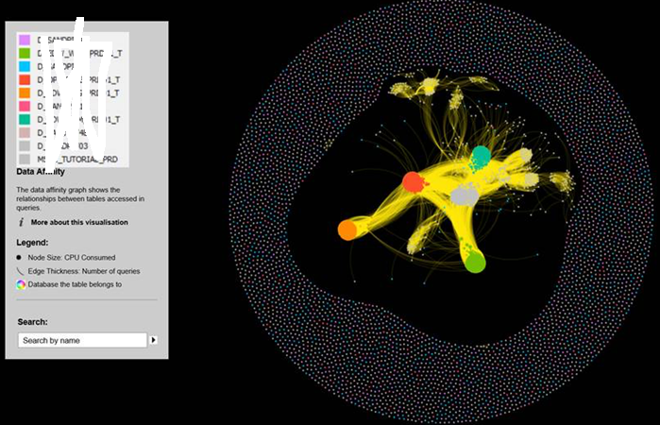

Offload and Manage the “disconnected” Tables
Many small disconnected and unused tables suggests that temporary work tables are not being cleaned up.
could impact backup performance/window
Recommendation:
Initial analysis and cleanup required
Automated cleanup of work tables
Ongoing process to cleanup unused tables
PAYROLL & CREW SCHEDULING

Slide 41
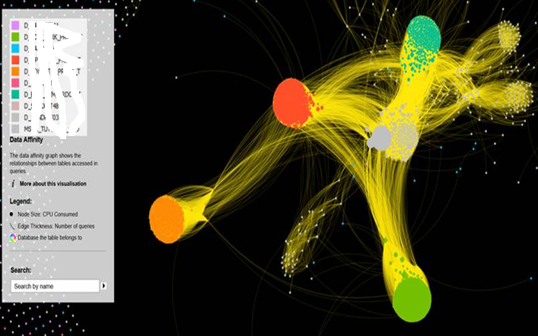
3 Tier Architecture Prominent
Prominence of 5 databases involved in the 3 Tier Architecture show good adherence to data architecture patterns
Shows good architecture practice and management
Evidence of highly integrated data providing a platform many use-cases for that data
Operational Image not used much outside the 3 Tier Architecture
Are power users and sand pits getting access to leverage un-integrated data?
Not much adhoc analytics – Vantage not being used for Analytics

Slide 42
Outline
Purpose and Context
Purpose
System Summary
Key Findings
Recommendations
Analysis and Findings
System Consumption
Feature Usage
Workload Profile
Data Affinity
Data Usage Profile
User Profile
Appendix – Feature Usage Grouping
Notes:
System Consumption – CPU / IO / Disk
Feature Usage
Workload Profile
Query Concurrency
Query Complexity (table joins)
Mixed Workload
Data Affinity
Data Usage (profile)
User Profile

Slide 43
Data Usage Profile Findings
Which user groups are making good use of key data assets?
Marketing Automation is a heavy user across all data domains – especially Agreement
Customer Strategy and Growth, Channel Transformation and “BI” departments are also strong users
Which user groups are not?
Enterprise Delivery, Loyalty and SAP Practice only use a handful of data domains
Are there data subject areas that should be used by user groups, but are not?
Provider and Site stand out as key subjects area for Customerx’s industry that are not being used much at all
Are there duplicates of key data domains/subject areas?
Chronic Disease Management appears across multiple Domains – could it be a domain itself?
Which user groups are heavily using the duplicates?
None stands out
Could efficiency and value be uplifted by merging the data?
The Semantic Model seems fragmented and there is duplication across dimensional models
Can usage of data subject areas be improved for user groups that heavily use them?
Not evident
Correlate data usage with data affinity, feature usage & user profile for hot areas
Answer

Slide 44
CPU Consumption by Department and Data Domain
Included Databases:
D_EDW_BASE_PRD01_T
D_EDW_SEM_PRD01_T
Excluded Departments:
Data Prep and Integration
Information Management
IT Applications
System
Notes:
Done ( Currently based on SQL joined to ref table)
Tableau sheet: CPUConsDepDomain

Slide 45
CPU Consumption by Department and Subject Area
Included Databases:
D_EDW_BASE_PRD01_T
D_EDW_SEM_PRD01_T
Excluded Departments:
Data Prep and Integration
Information Management
IT Applications
System
Notes:
Done ( Currently based on SQL joined to ref table)
Tableau sheet: CPUConsDepSubjArea

Slide 46
CPU Consumption by Business Group & Data Domain
Included Databases:
D_EDW_BASE_PRD01_T
D_EDW_SEM_PRD01_T
Excluded Departments:
Excluded Departments:
Data Prep and Integration
Information Management
IT Applications
System
Notes:
Done ( Currently based on SQL joined to ref table)
Tableau sheet: CPUConsBusGrpDomain

Slide 47
CPU Consumption by Business Group & Subject Area
Included Databases:
D_EDW_BASE_PRD01_T
D_EDW_SEM_PRD01_T
Excluded Business Groups:
Data Mover
Data Load and Unload Users
Administrator
ETL Framwork users
Notes:
Done ( Currently based on SQL joined to ref table)
Tableau sheet: CPUConsBusGrpSubjArea

Slide 48
Outline
Purpose and Context
Purpose
System Summary
Key Findings
Recommendations
Analysis and Findings
System Consumption
Feature Usage
Workload Profile
Data Affinity
Data Usage Profile
User Profile
Appendix – Feature Usage Grouping
Notes:
System Consumption – CPU / IO / Disk
Feature Usage
Workload Profile
Query Concurrency
Query Complexity (table joins)
Mixed Workload
Data Affinity
Data Usage (profile)
User Profile

Slide 49
User Profile Findings
Are there users who have higher than expected compute consumption?
Xxxx compute consumption is an out-of-orbit outlyer
Then Batch/System users are consuming the majority of compute
Followed by several individual users
Investigate workload for those users and identify improvement opportunities
Investigate workload for those users and identify improvement opportunities
Which users are extracting large amounts of data on the system?
Xxxx seems to be extracting large amounts of data from the system
Should they be using existing applications on the system instead?
Possibly – there are likely huge savings in extract and analysis time if data is integrated before being accessed to SAS
Are there downstream analytics systems that are not using pushdown processing?
SAS pull large amount data out, this could be tunned using pushdown processing.
Are the users taking data outside of the system for experiments?
Possibly – SAS users
Are human users running a lot of batch workload?
NO
Are users getting a good overall experience on the system?
Generally good – only some delay time for batch users currently
Has the compute usage changed significantly for certain users?
Find out why
Are users being impacted by query delays or system congestion?
Some batch users are being impacted by unnecessary query delay.

Slide 50
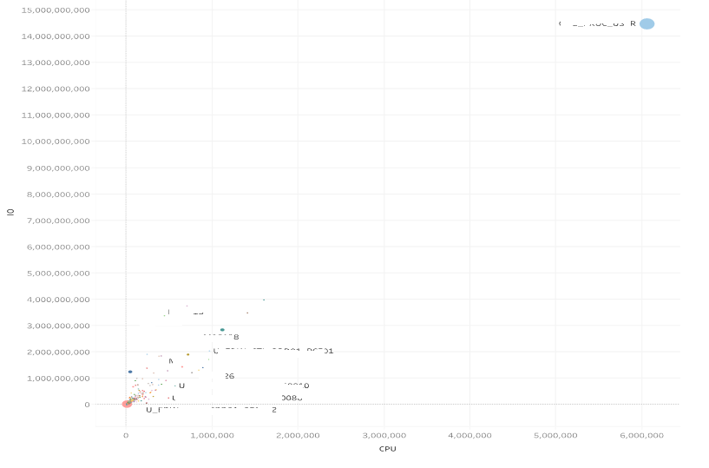
High Activity Users – xxx
Xxx is dramatic outlier in terms of massive CPU and IO utilization in comparison to other users
What is the usage pattern of this user?
Could the usage be optimized?
It is understood xxx is running thousands of queries per day – mostly single table selects – to feed data to the downstream SAS server.
This process could be optimized by enabling SAS to access data directly from Vantage using the SAS Access for Teradata connector:
Less data movement over the network
Leverage Vantage optimizer for complex processing
Faster time-to-outcome
Notes:
Tableau sheet: HighActivityUsers

Slide 51
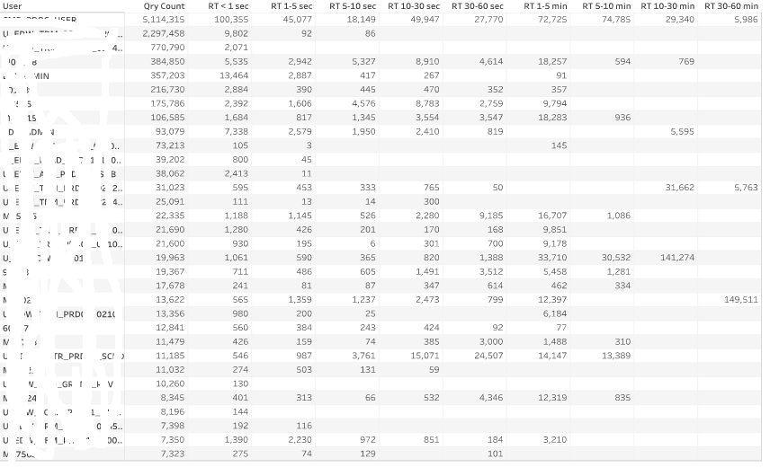
Understand Customer Experience
Xxx is running 70,000+ queries per day
Many simple extract full table queries
Could extraction be simplified and utilize Vantage SQL to prepare the data before extracting?
Around 1,000 of these queries run for > 10 minutes – are these big full table scans that are just being repeated?
Xxx is running thousands of long-running queries (5-30 minutes)
Xxx is running thousands of queries that run for more than 30 minutes – this should be a focus individual user.
Notes:
Tableau sheet: QueryRunTimes

Slide 52
Consumption KPI – User Experience
Throughput, Workload Type, Query Volume
Up to 700 queries per minute (average) in some hours.
Spike of requests around 28-April – was this seasonal?
Notes:
Done

Slide 53
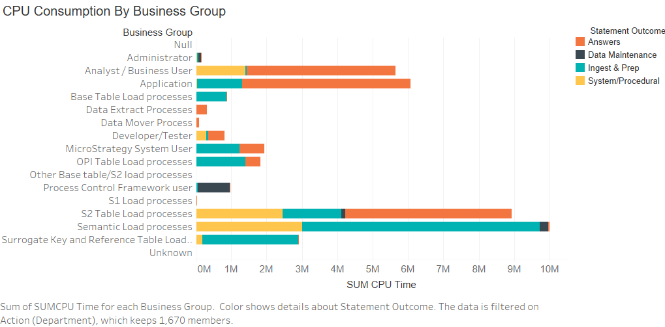
CPU by Workload Type
Queries compared to ETL show a healthy proportion
Very little Load workload – but this is likely being hidden in the ETL workload type by Informatica?
Notes:
Tablleau: BusinessGroupCPU

Slide 55
Appendix
Feature Usage Grouping

Slide 56
Feature Usage Grouping
In-Database Analytics Features (42)
Advanced Data Types
Advanced SQL Functions
In-Database Programming
Geospatial
Temporal

Slide 57
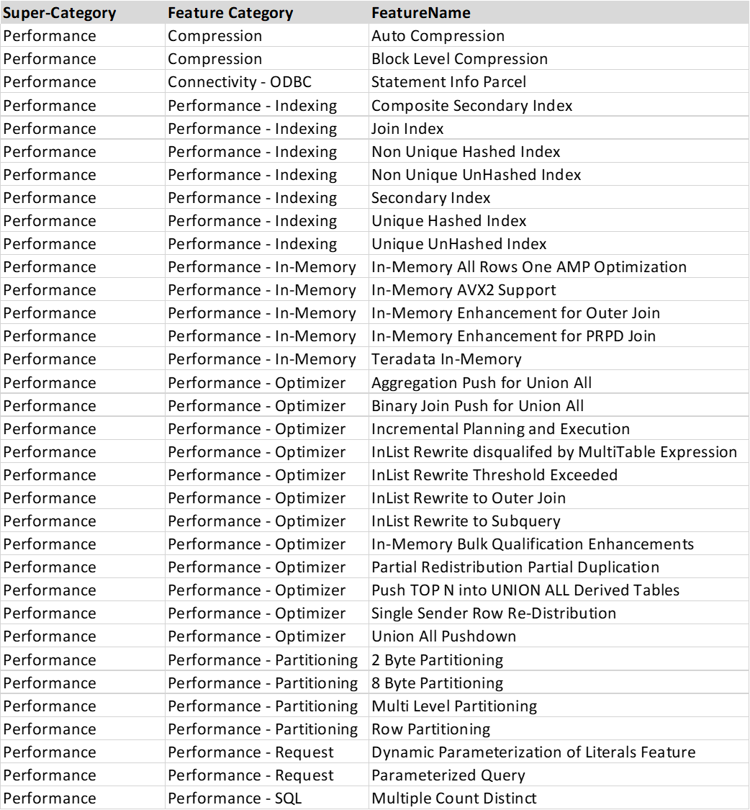
Performance (34)
Indexing
In-Memory
Optimizer
Partitioning
Compression

Slide 58
Data Optimization (23)
Data Distribution
Data Loading
Data Management
Columnar
QueryGrid

Slide 59
Usage Analysis (14)
DBQL Logging
Stats/Index Analysis
High Availability (9)

Slide 60
Query Complexity Classification
Level ==> |  | Simple | Medium | Complex | Very Complex
 |  | 1 | 2 | 3 | 4
Item | Weight
Joins | 1 | 1 to 2 | 3 to 6 | 7 to 12 | >= 13
Aggregations | 0.25 | 1 | 2 to 4 | 5 to 10 | >= 11
Analytic Functions | 1 | 1 | 1 to 2 | 3 to 5 | >= 6
Std Functions | 0.25 | 1 to 2 | 3 to 6 | 7 to 12 | >= 13
Data Transform | 0.25 | 1 to 2 | 3 to 6 | 7 to 12 | >= 13
Text Functions | 1 | 1 | 2 | 3 to 5 | >=6
xxxx function | 0.5 | 1 | 1 | 3 to 5 | >=6
The basic concept states for calculating query complexity is:
The four levels are defined by a cumulative complexity from many aspects of the query.
There is a Weight assigned for each function
(the number of functions) x (weight) = function value for the query
Aggregation of all function values for a query will result in complexity score
©2019 Teradata

